Slide 1
Outline for 10 minutes
Inspiration behind choosing anthem recognition & show database.
feature extraction scheme.
HMM design about numb of states, output distributions etc..
About training and testing of the system.
Image/chart of confusion matrix
Discuss what aspects of the data the HMM has learnt to describe.
Show misclassified instances & reason.
Live demo of our own voice.
Concl: strength and weakness of the system & outcomes.
Notes:
Group 4 13.30-13.45 May 31st Meeting room, floor 4th, Osquldas väg 10

Slide 2
DD2341
Song recognition
Yann Debain Harsha HN
Notes:
Introduce self: masters + specialization

Slide 3
Problem Statement
To build system capable of classifying an input melody snippet into relevant national anthem group.
“National anthem melody recognition system”
Notes:
Inspiration behind choosing anthem recognition and about the problem we’re solving!

Slide 4
Dataset Preparation
Melodies of national anthem
10 Countries:
10 records for each melody
France | Sweden
Portugal | Germany
Great Britain | USA
Russia | Greece
Belgium | China
Creating database of melodies
Notes:
Play few melody from the database

Slide 5
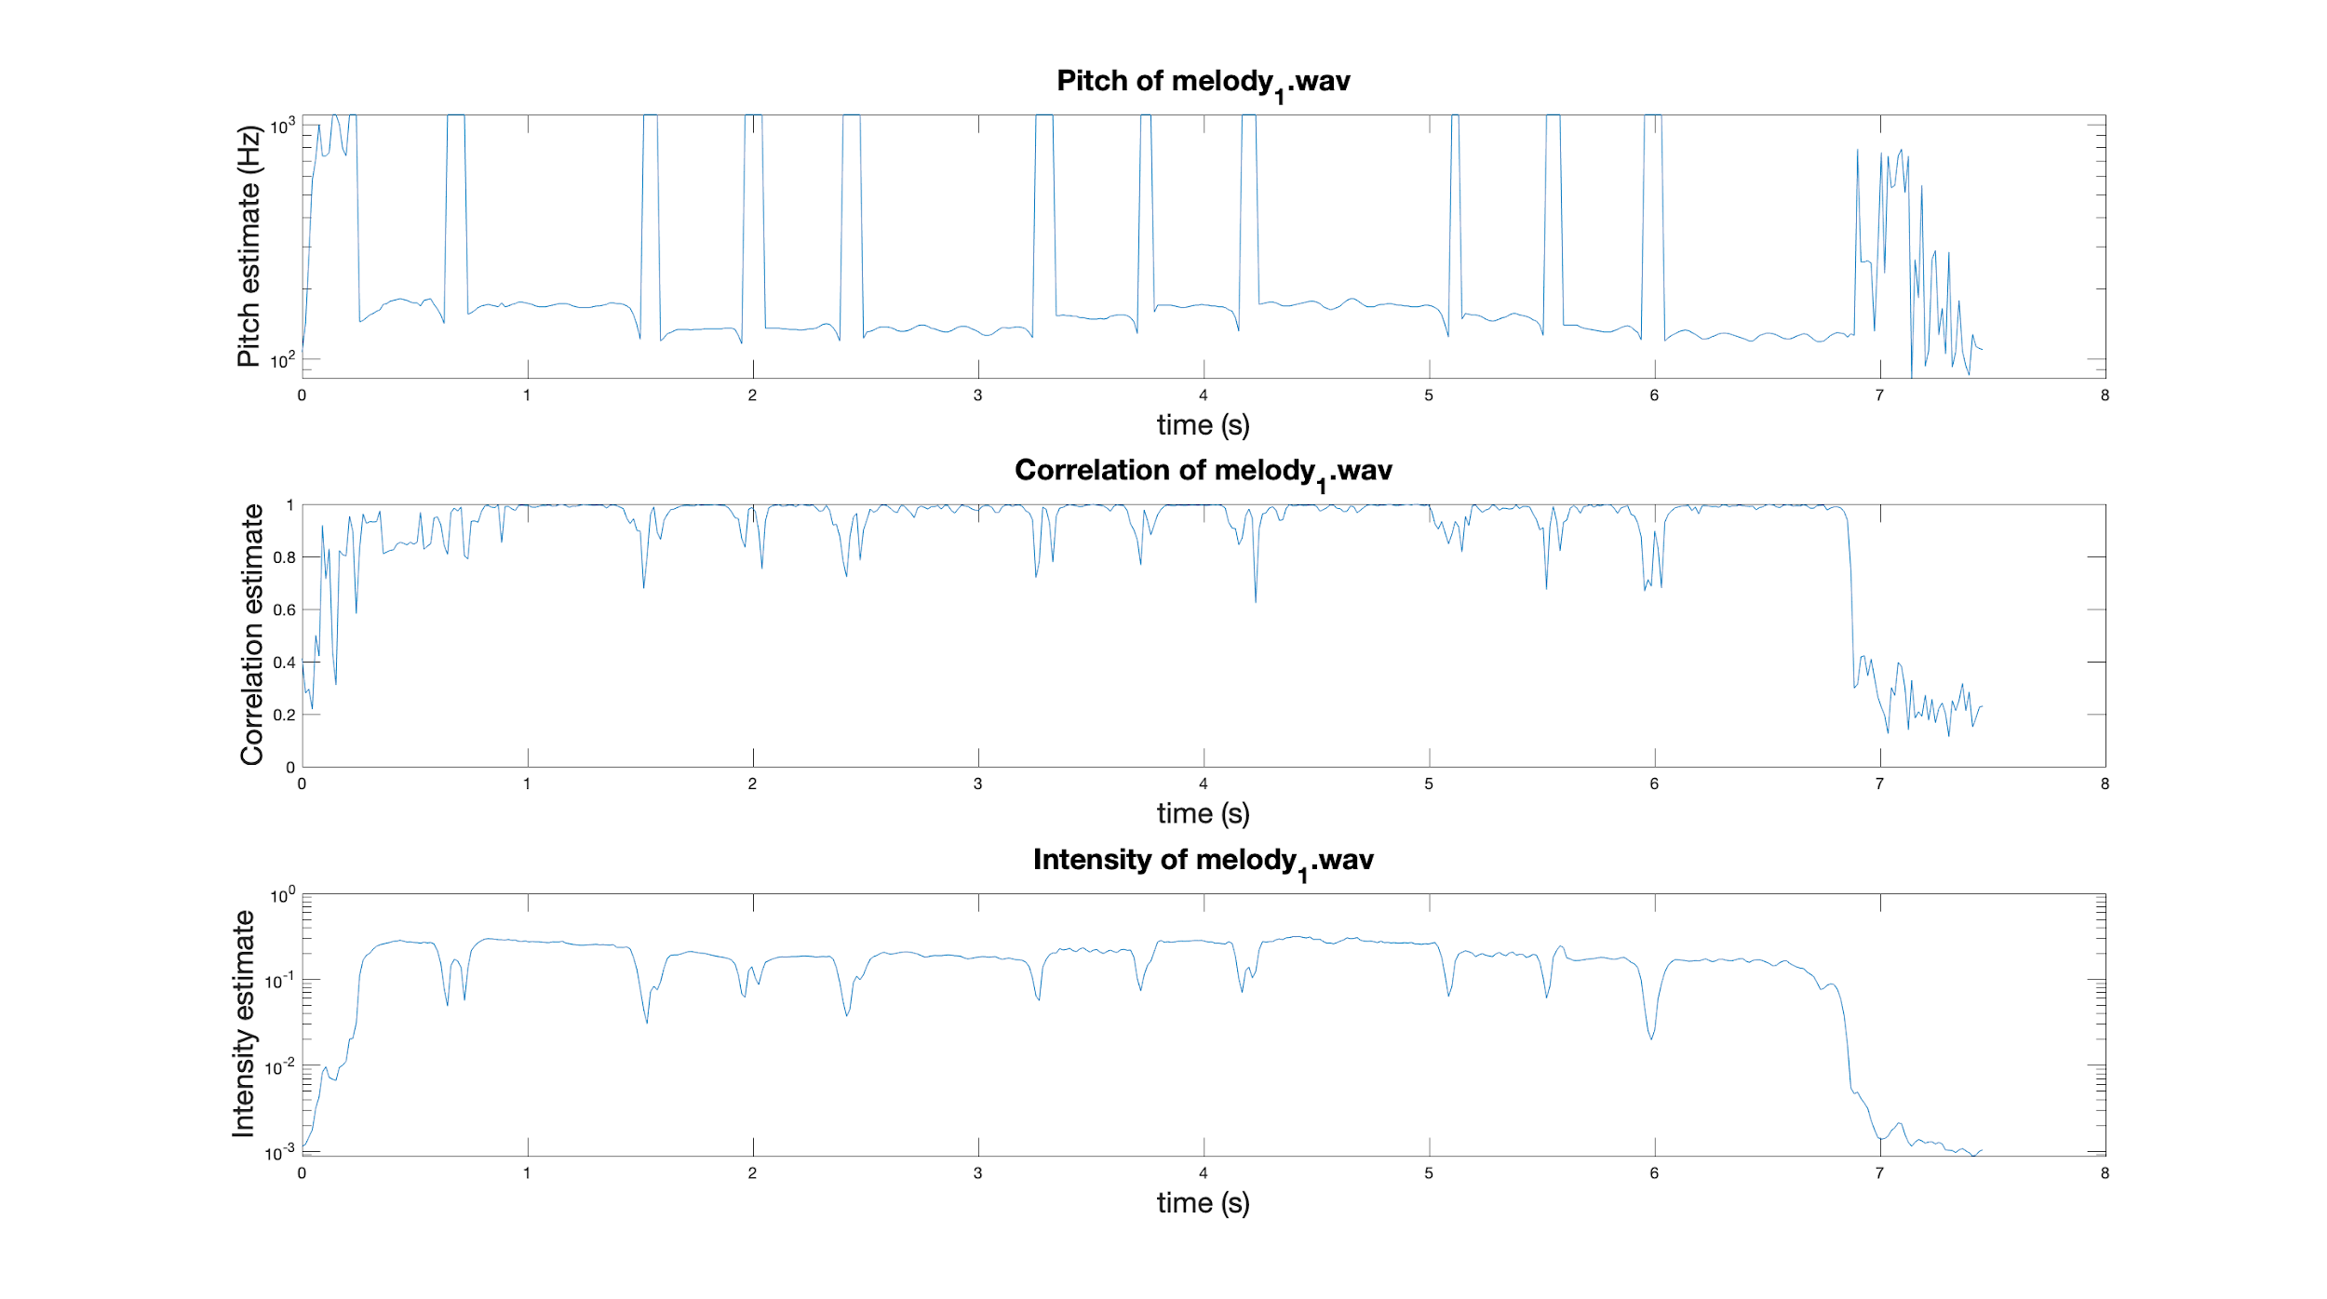
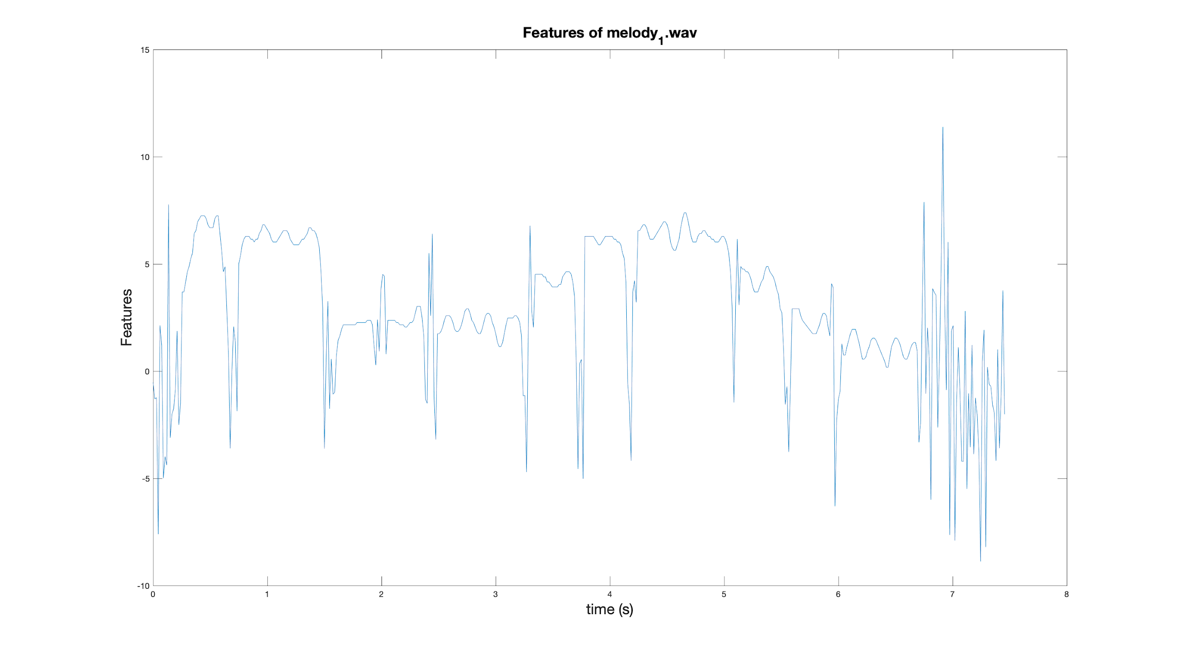
Dataset Preparation
Extract features: Pitch, Correlation and Intensity
Post processing: Remove non-harmonics, Add noise and Semitones transformation
Feature extraction scheme
Notes:
Post processing ensures robustness in Volumes, Transpositions(Jump in semitone or octave),

Slide 6
System design
New melody
melody
Features Extractor
Left-Right HMM
Trained HMM
Train LR HMM
Init LR Markov chain
Prediction
Init LR HMM
Training stage
Prediction stage

Slide 7
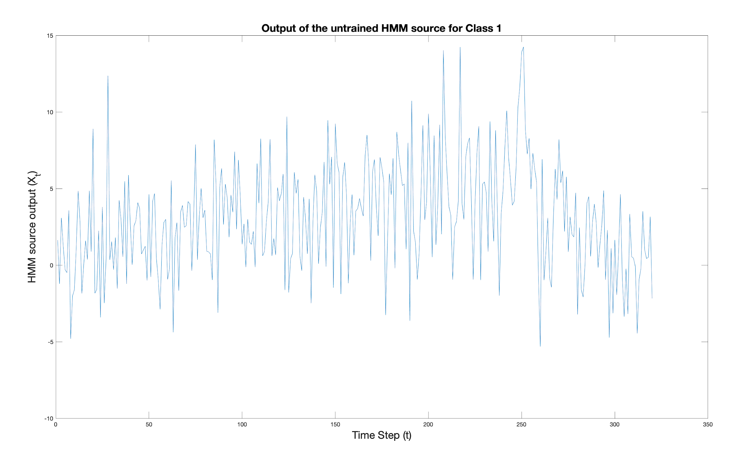
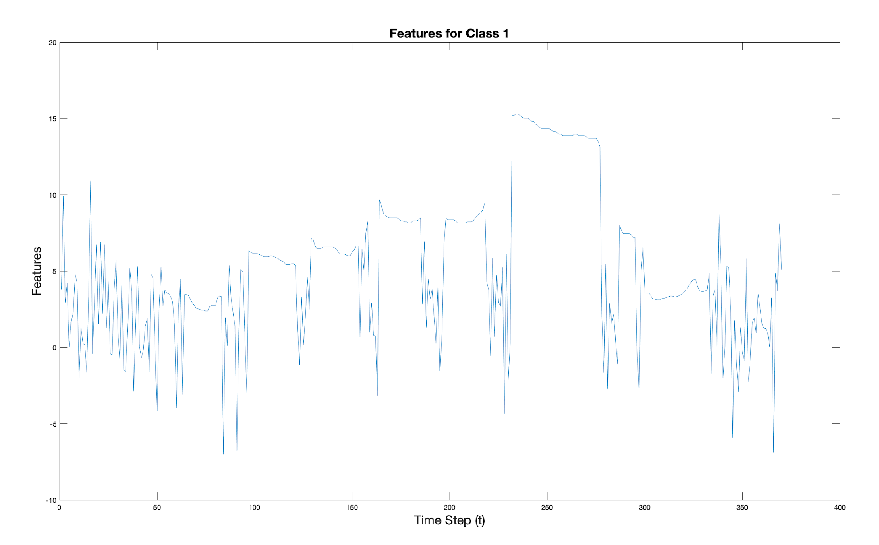
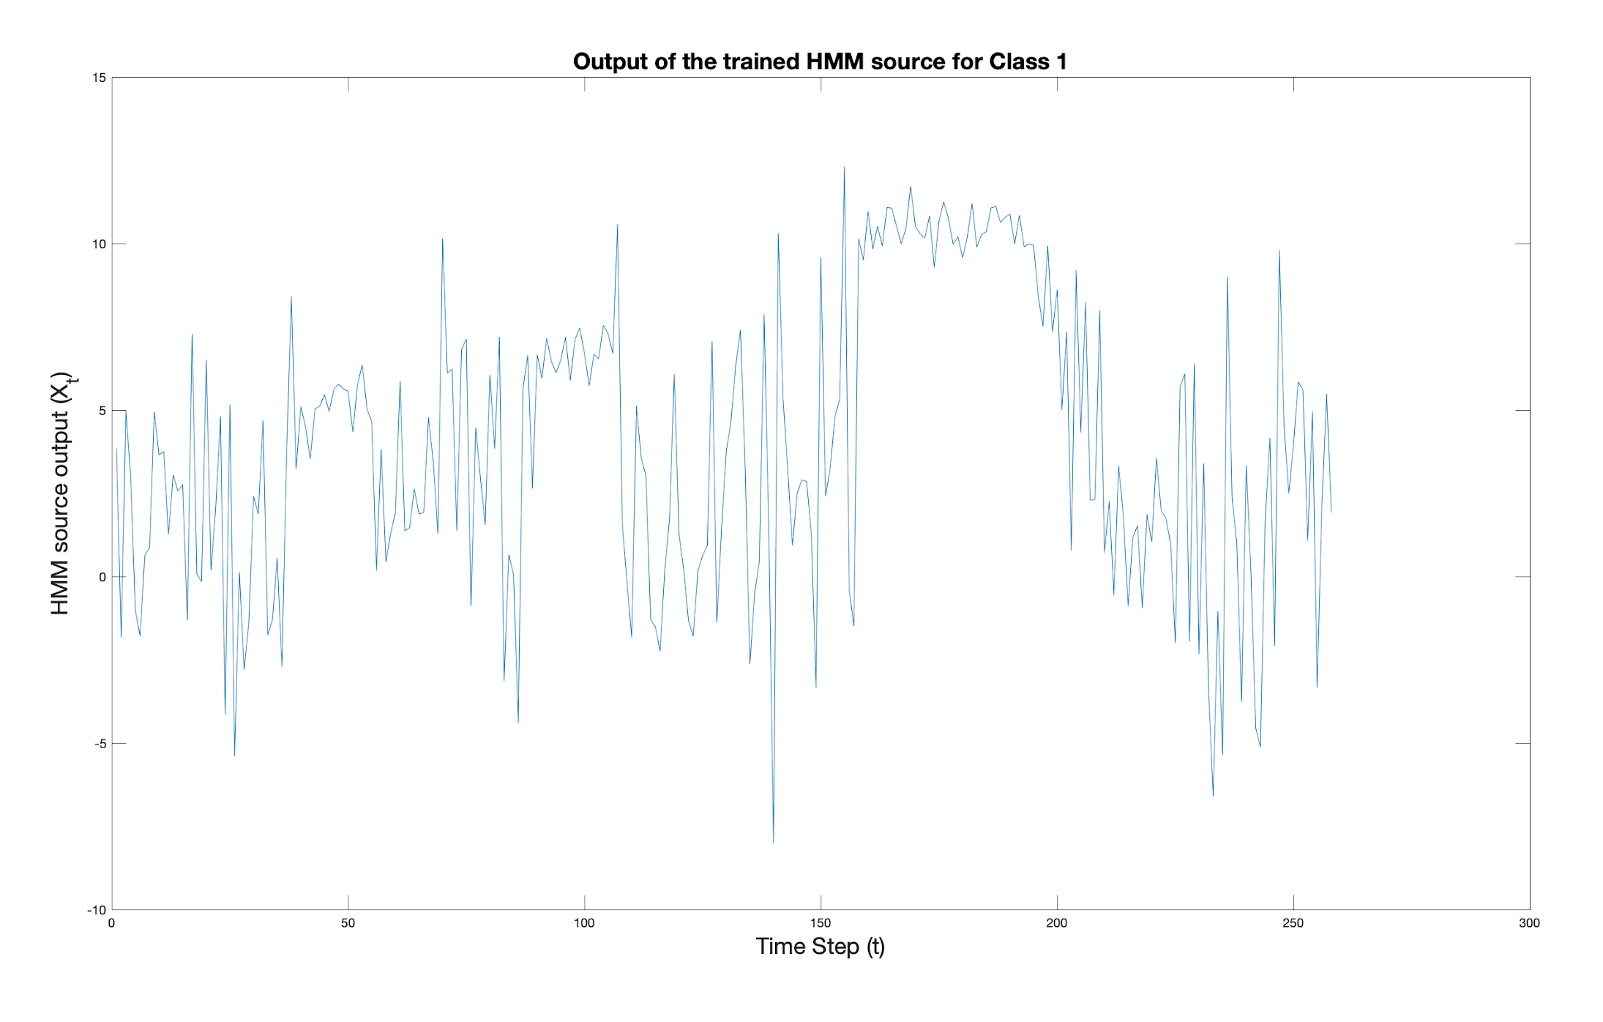
Training process
Untrained HMM
Trained HMM
Features for class 1

Slide 8
Performance Evaluation
Confusion Matrix
 | Prediction
 | 1 | 0 | 0 | 0 | 0 | 0 | 0 | 0 | 0 | 0
 | 0 | 1 | 0 | 0 | 0 | 0 | 0 | 0 | 0 | 0
 | 0 | 0 | 2 | 0 | 0 | 0 | 0 | 0 | 0 | 0
 | 0 | 0 | 0 | 1 | 0 | 0 | 0 | 0 | 0 | 0
 | 0 | 0 | 0 | 1 | 2 | 0 | 0 | 0 | 0 | 0
 | 0 | 0 | 0 | 0 | 0 | 2 | 0 | 0 | 0 | 1
 | 0 | 0 | 0 | 0 | 0 | 0 | 2 | 0 | 0 | 0
 | 0 | 0 | 0 | 0 | 0 | 0 | 0 | 1 | 0 | 0
 | 1 | 1 | 0 | 0 | 0 | 0 | 0 | 1 | 2 | 0
 | 0 | 0 | 0 | 0 | 0 | 0 | 0 | 0 | 0 | 1
True Class
Performance ~ 60% - 80%
Overall accuracy : 75%
Notes:
Reason behind misclassification?

Slide 9
Live Demo

Slide 10
Conclusion
Data work, Training & performance evaluation gave ~ 60% - 80% accuracy.
Strengths and weakness of our model
‘+’ Robust to transposition, pitch halving/doubling
‘-’ Robustness to high variations in a melody
Learning outcomes
OOPS in Matlab
Solving a pattern recognition problem
Feature extraction, HMM init, training and evaluation.

